Slide 1
Sellerkart
Presentation By:
Aman Giri
Akshata Naik

Slide 2
Introduction :
This system is designed especially for large, premium and small retailer business and the local wholesalers. E-retailer portal provide the complete functionality of placing the order from the retailer and acknowledgement from the same and getting the orders accepted from the wholesaler. This system is going to provide ease of comparison with the price of the same product and also the location with the different wholesalers.

Slide 3
Need Of the System :
In this modern era still entire business model between retailer and wholesaler are either rely on past relations they maintain or just verbal convincing approach by wholesaler which means no confirmation of delivery date and rate of product.
For not knowing different wholesalers available in the market, retailers buy products only from the wholesalers they know and end up giving high rate
Many times due to late delivery of product by wholesaler the retailer has to return their valuable customer which substandard the customer relation

Slide 4
Actors and Functions:
Admin:
Admin can delete, manage Retailer/wholesaler as per review
Wholesaler:
Wholesaler can upload the item name and its quantity on portal and alter it any time.
Wholesaler can see list of orders requested to him by retailer to supply item.
Wholesaler will approve the request of retailer whom he wants to supply product.
Wholesaler can check if the product has delivered to retailer or not.
Wholesaler can give rating to retailers.
Retailer:
Retailer can upload the item name and its quantity on portal and alter it any time.
Retailer can check his shops items quantity and filter out products under threshold limit which need to be fulfilled on time.
Retailer will request for product under threshold limit to filtered out wholesaler by the portal as per location and rate of product.
Retailer can send received status to wholesaler when the product is arrived.
Retailer can give rating to wholesaler.

Slide 5
Technology Used:
Front End: ReactJs
Back End: Java Spring Boot API.

Slide 6
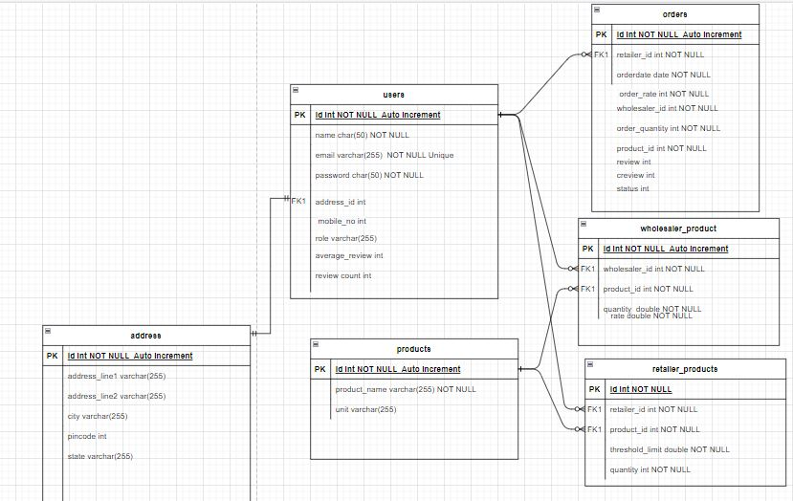
Entity Relationship Diagram

Slide 7
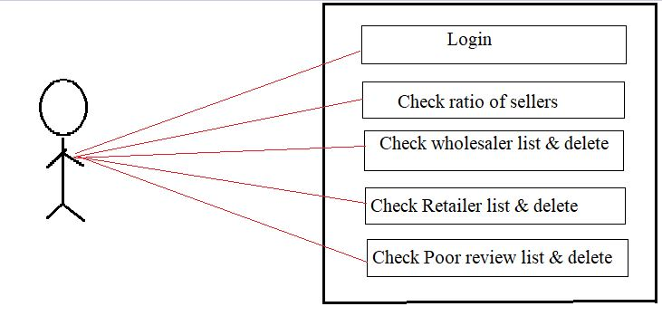
Usecase Diagrams:
Admin:

Slide 8
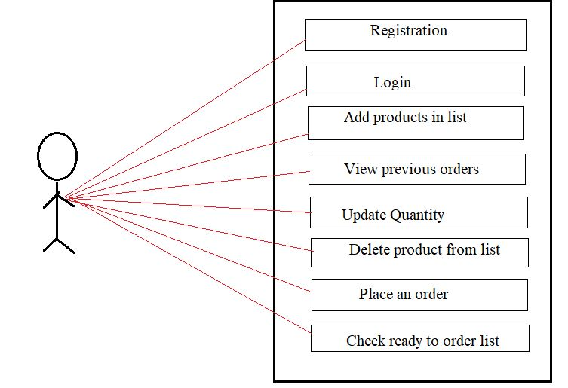
Usecase Diagrams:
Retailer:

Slide 9
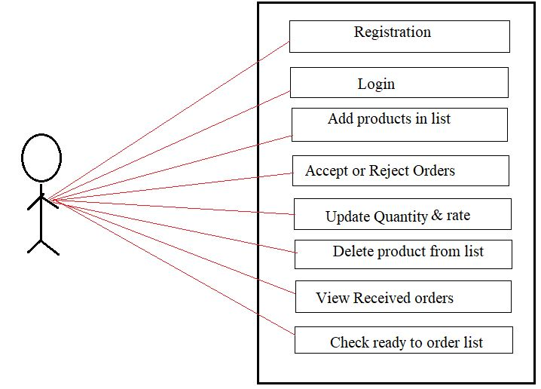
Usecase Diagrams:
Wholesaler:

Slide 10
Screenshots

Slide 11
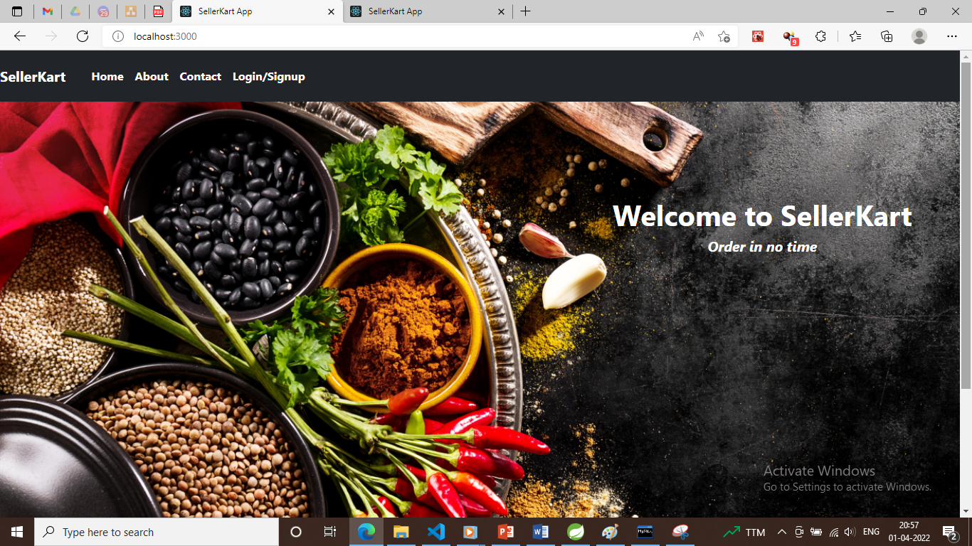

Slide 12
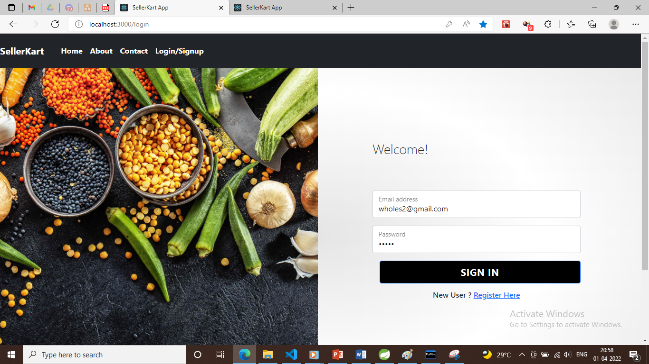

Slide 13
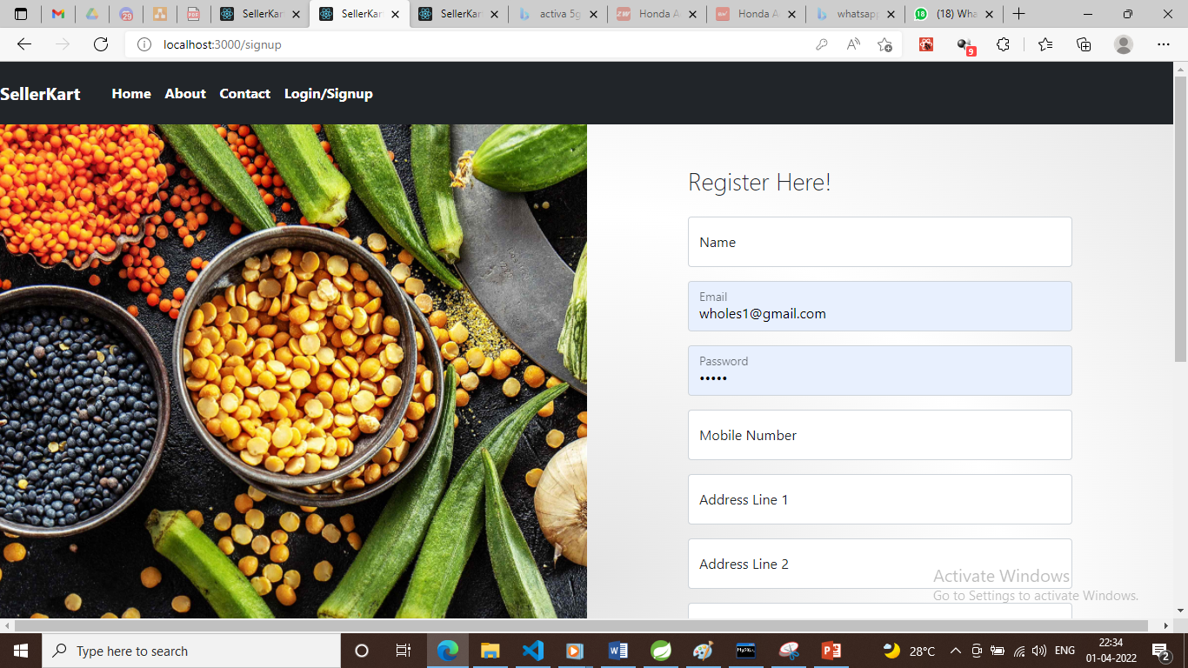

Slide 14
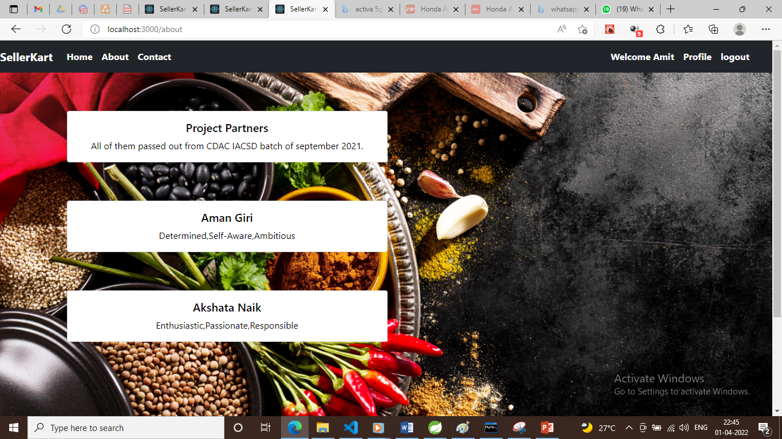

Slide 15
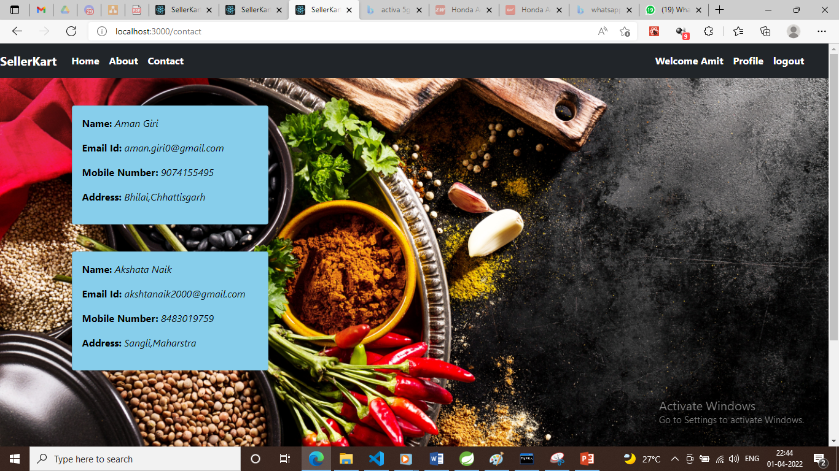

Slide 16
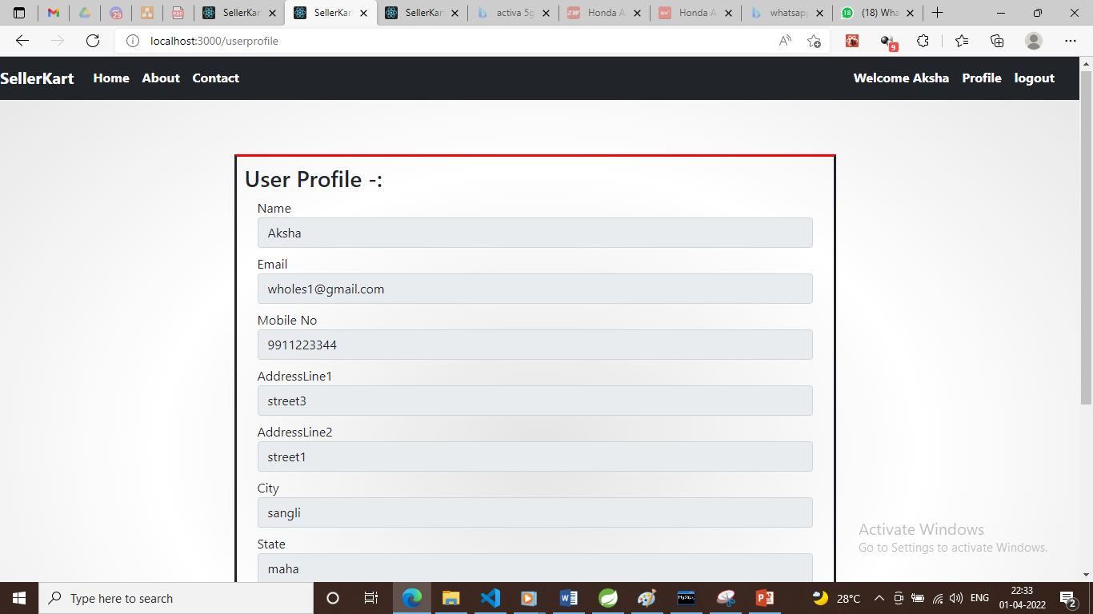

Slide 17
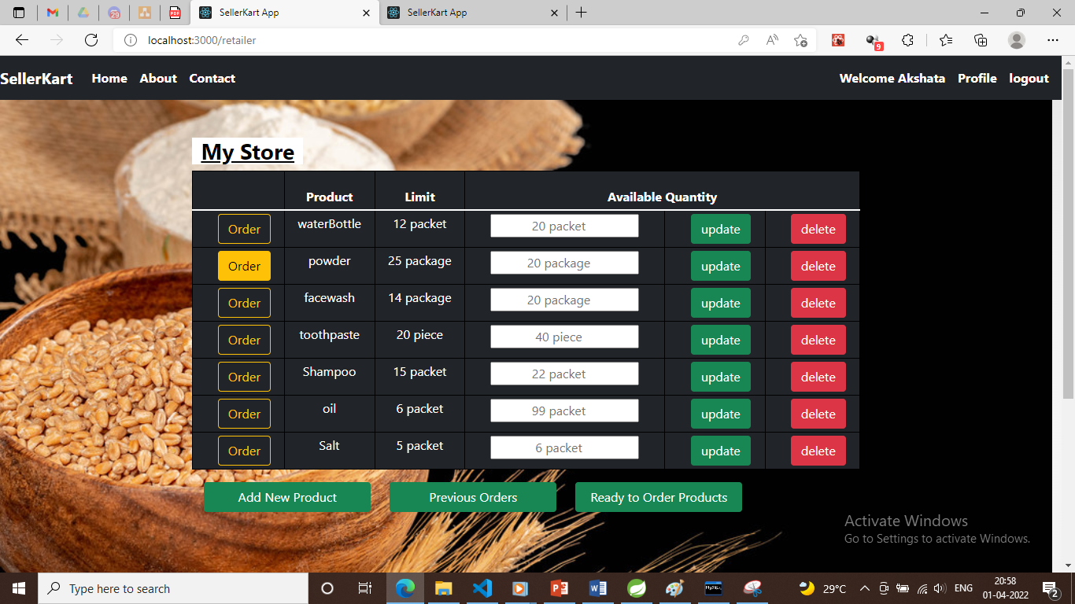

Slide 18
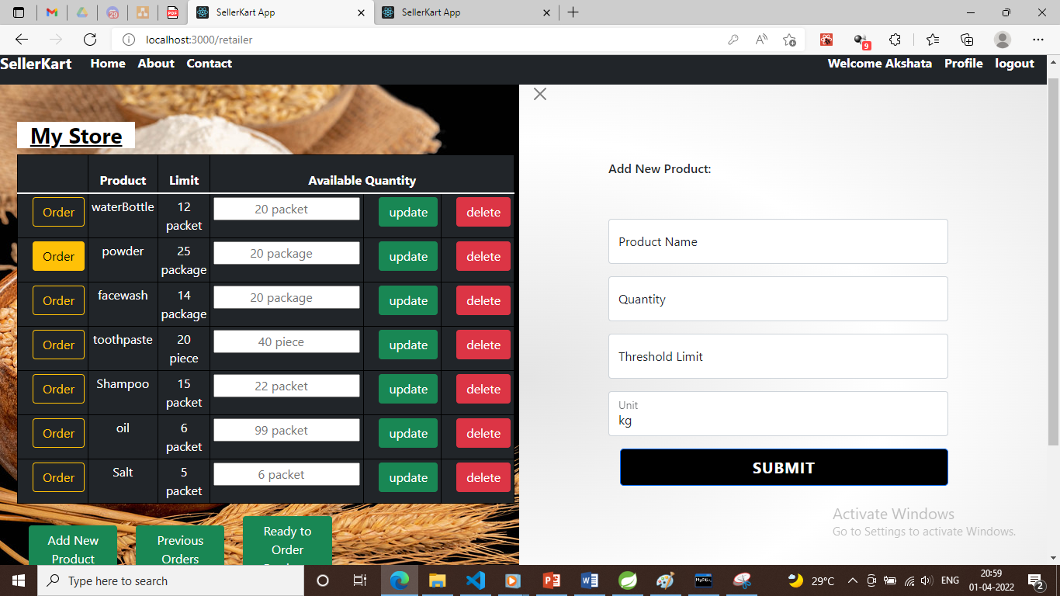

Slide 19
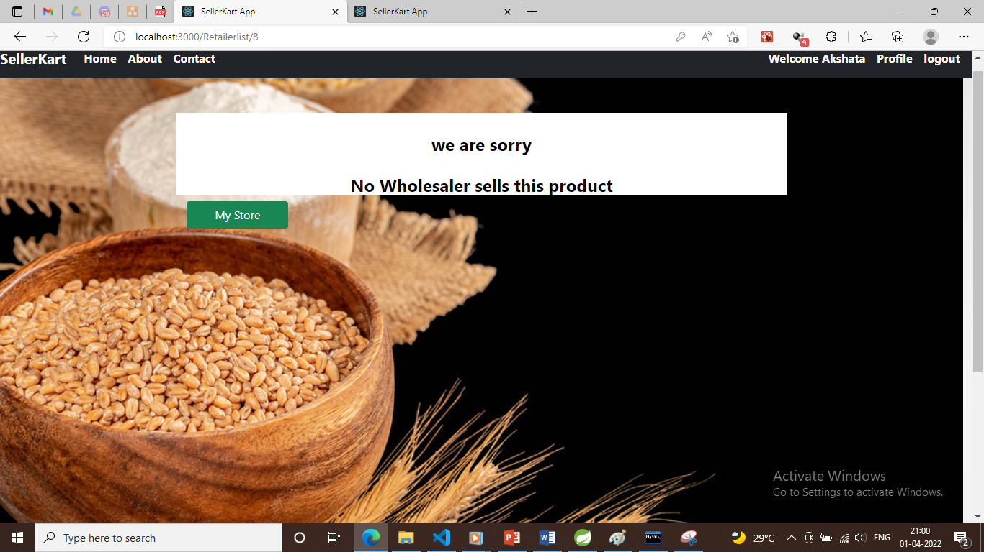

Slide 20
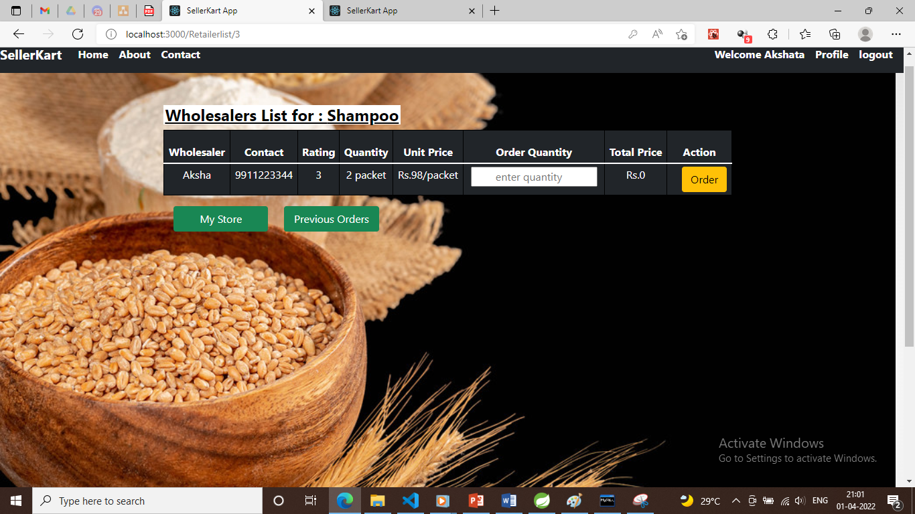

Slide 21
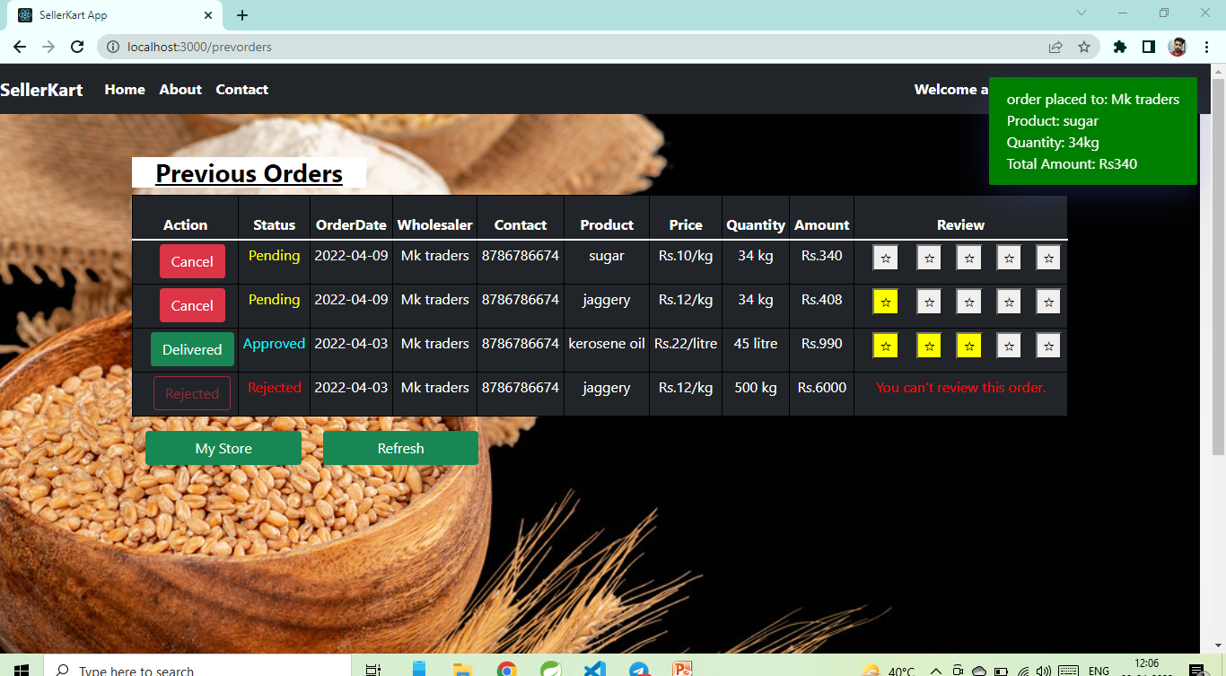

Slide 22
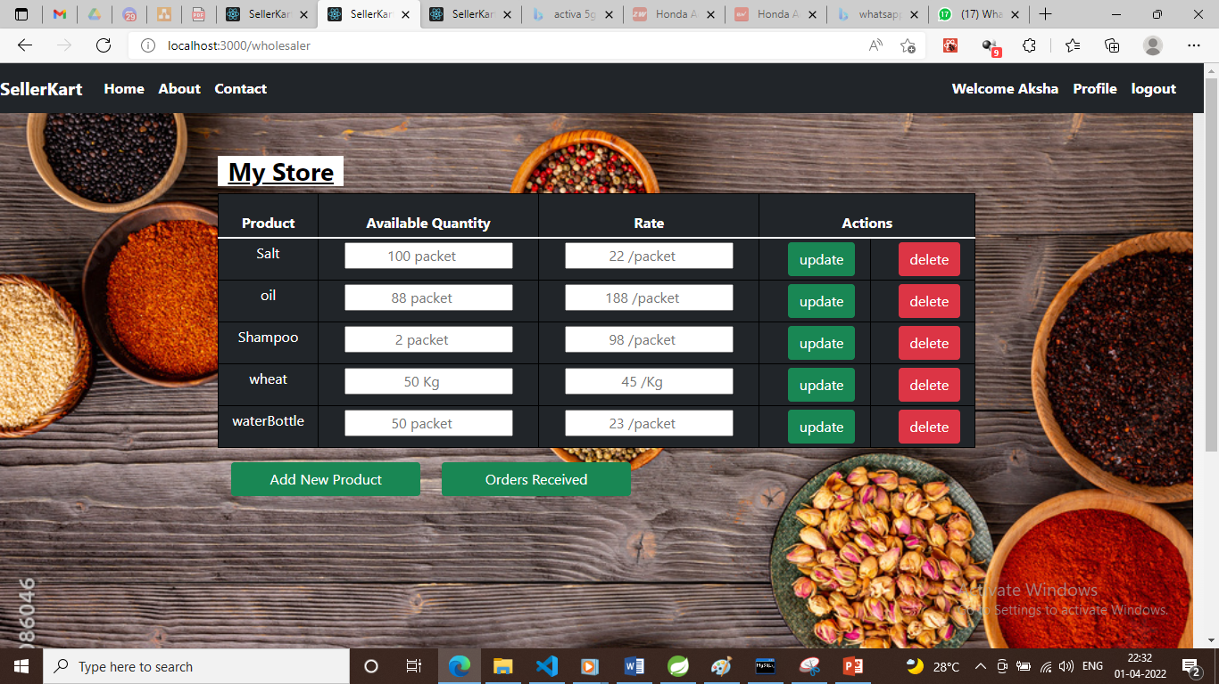

Slide 23
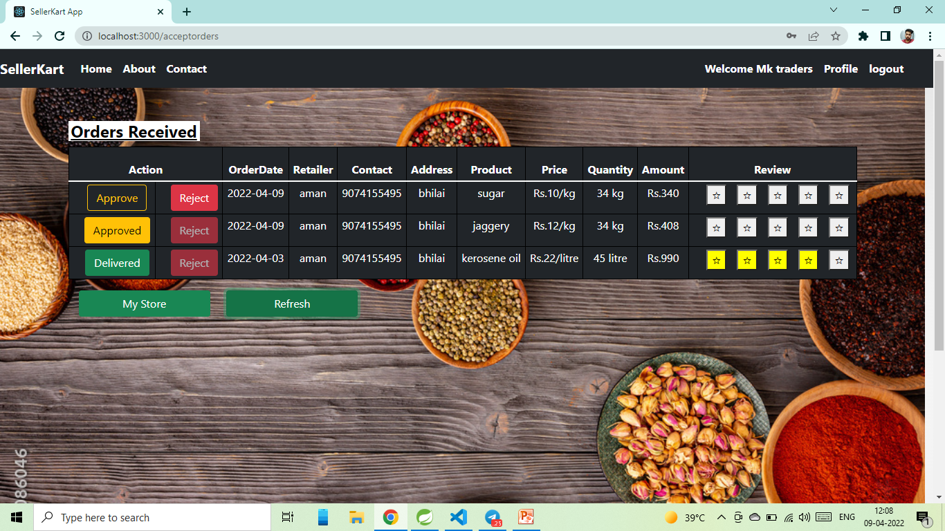

Slide 24
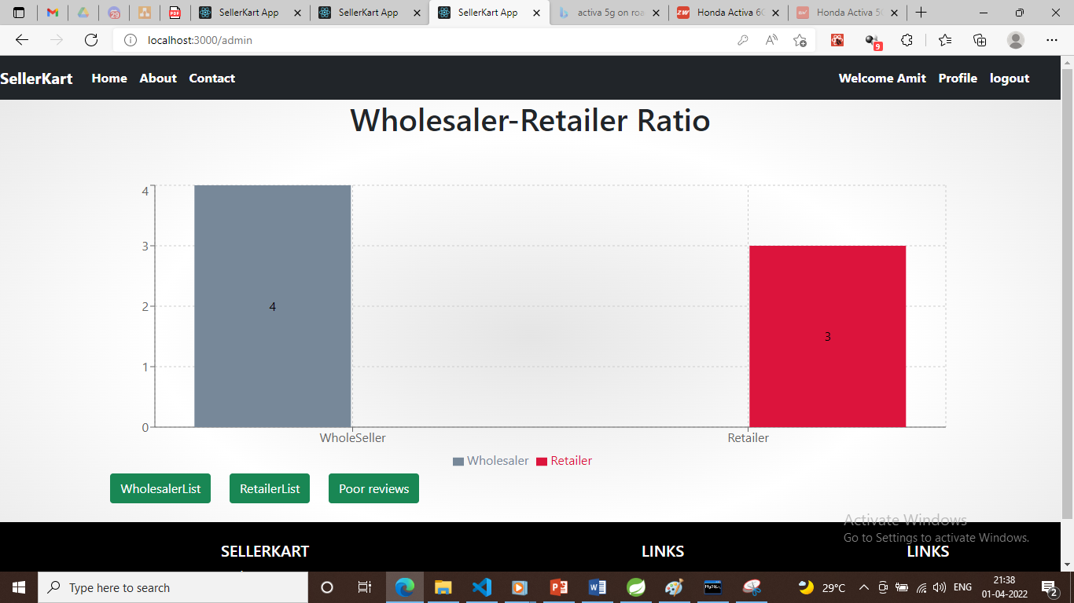

Slide 25
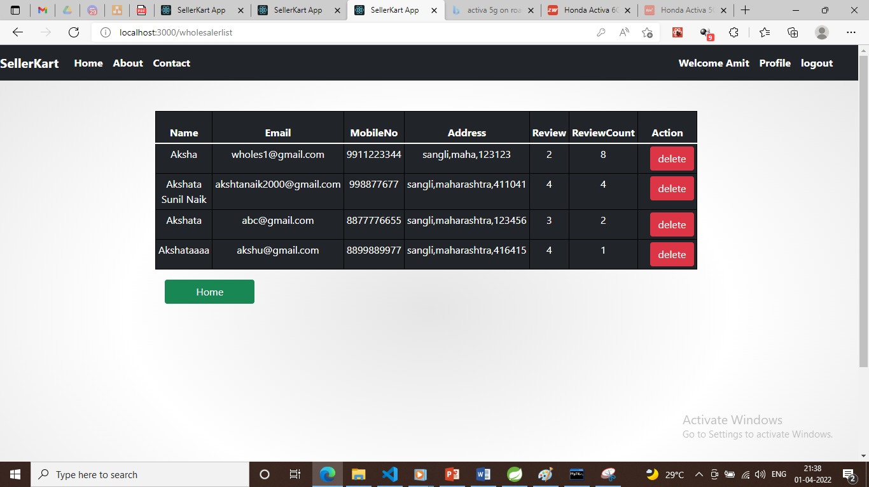

Slide 26
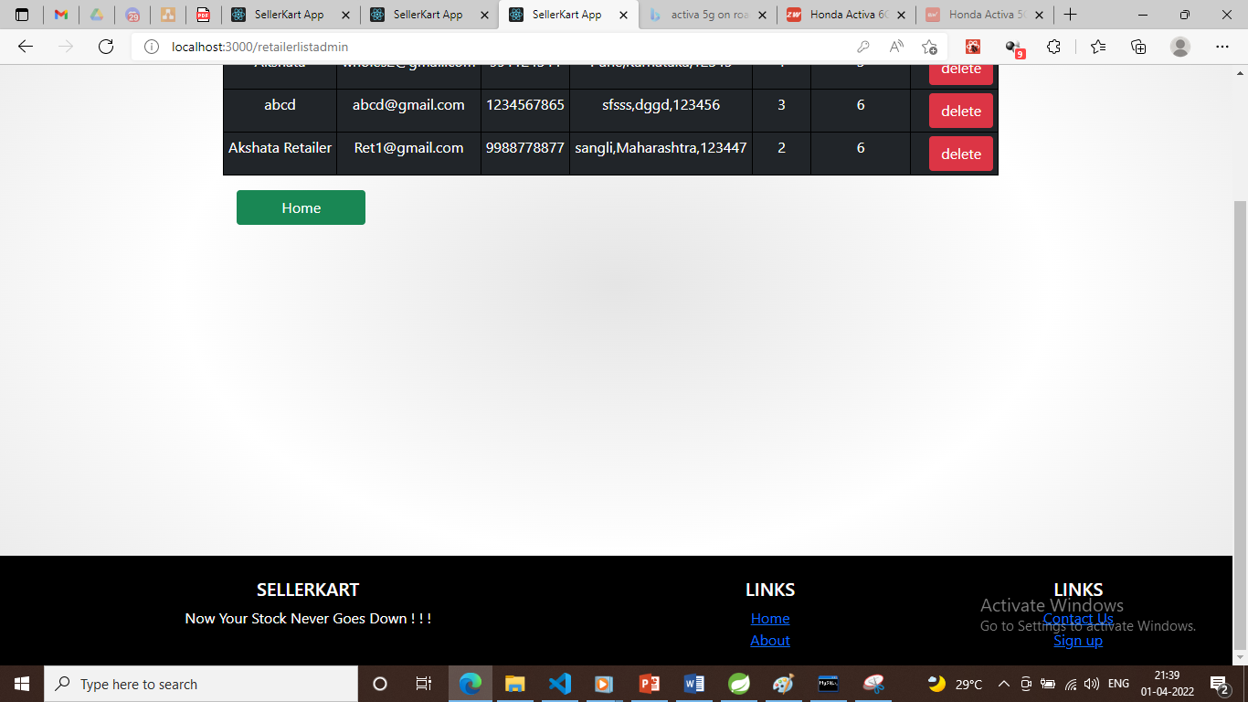

Slide 27
Thank you !

